Slide 1
Upcoming Events
Friday, Sept. 17th Student Council Elections
Tues. Sept. 21st College Application Workshop 4-8 PM
Thurs. Sept. 23rd Virtual 12th Grade Parent Meeting 5:30-7 PM
Fri. Oct. 1st FAFSA Online
Fri. Oct. 1 9:30 AM St Eds Representative
Monday, Oct. 11th ACC is open
Tues. Oct. 5th FAFSA Workshop 5-7 PM
Weds. Oct. 20th BEST College Night 6:30-8:30 PM
*Scholarship Applications are due 10/31/2021*

Slide 2
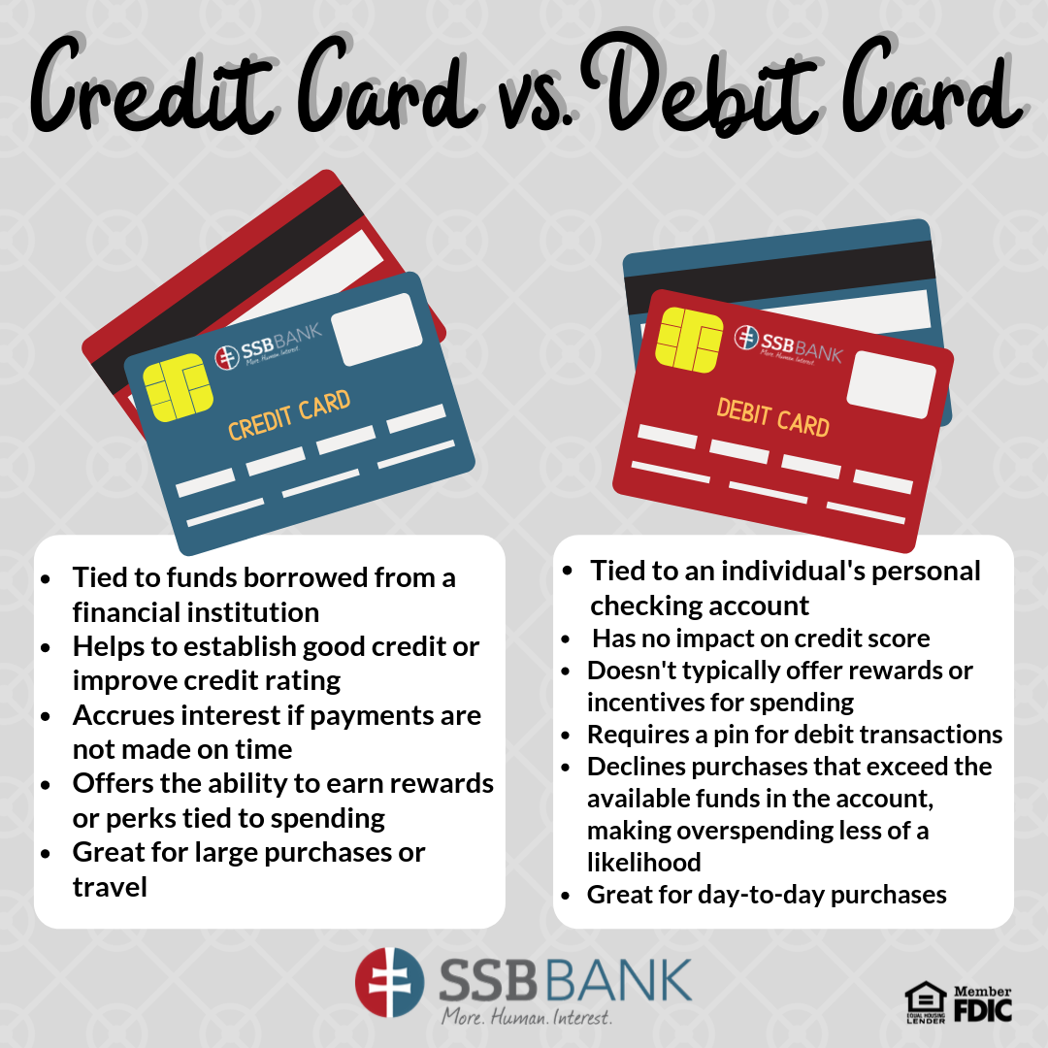
Adulting 101-Credit Score
What’s the difference between a
credit card and debit card?

Slide 3
Adulting 101-Credit Score
What is a credit score?
A credit score is the number that represents your creditworthiness.
Creditworthiness is the likelihood that you will repay your debt, whether it is a car loan, get an apartment, get a job or a student loan.
Credit Score is also commonly referred to as a FICO score, since FICO is the most popular credit score company.

Slide 4
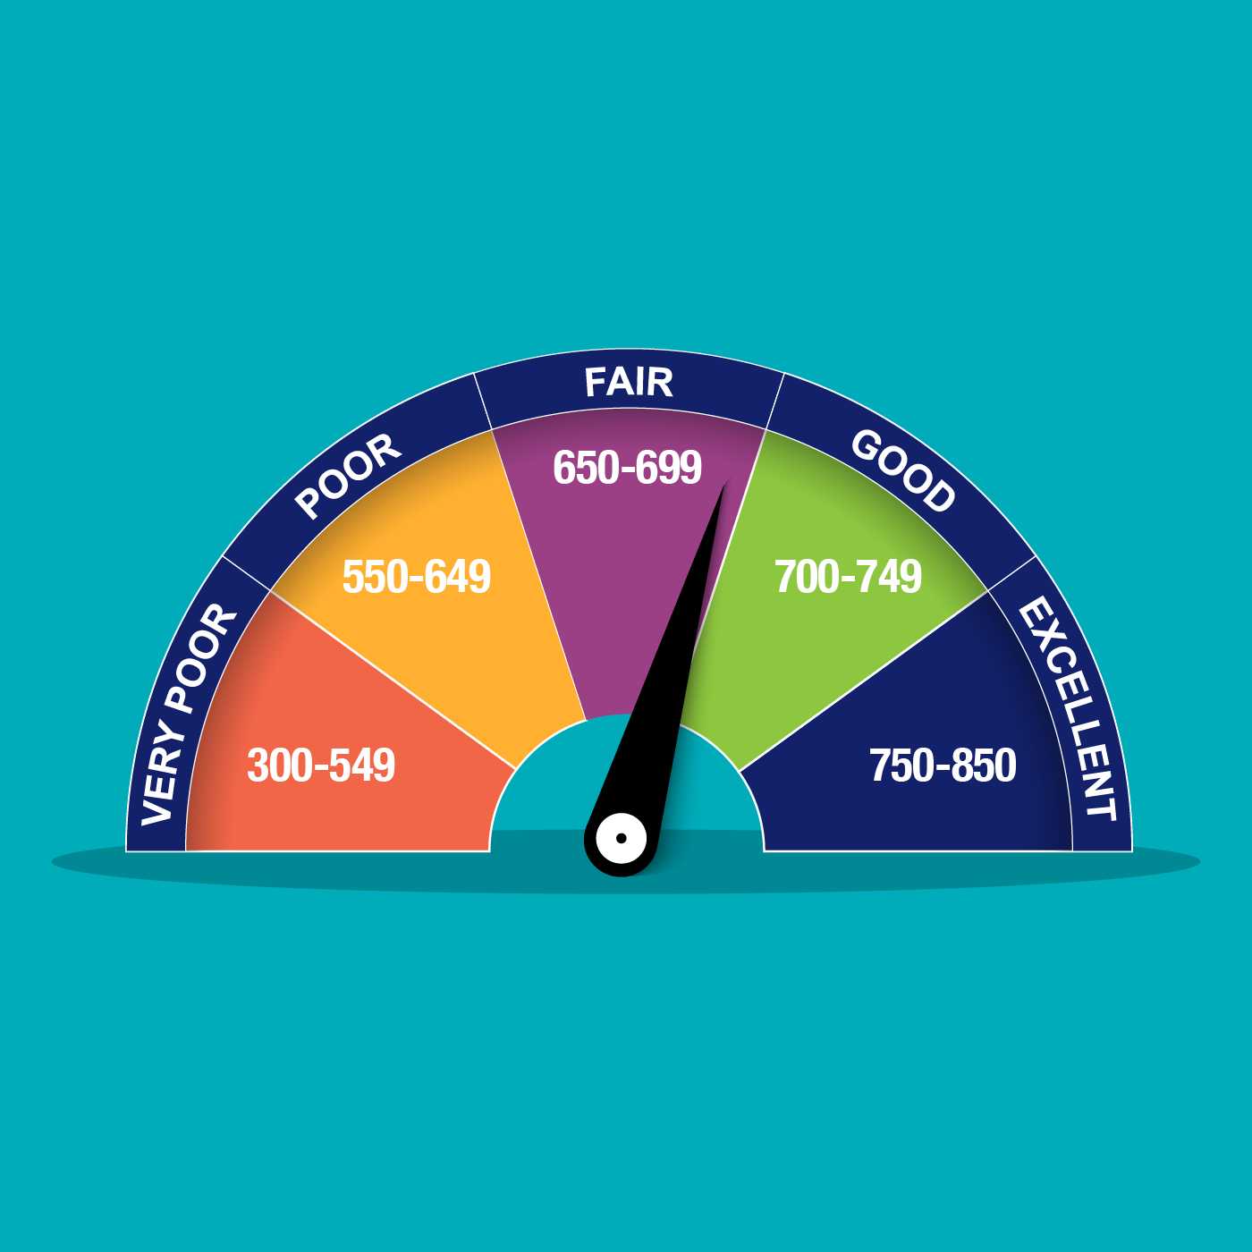
Adulting 101-Credit Score

Slide 5

Adulting 101-Credit Score
The average credit score in the U.S. is around 700.
The higher your score the more likely you are to get a loan and a lower interest rate.
This can save you thousands of dollars in payments to the bank or credit card company.

Slide 6
Adulting 101-Credit Score
If you have a low credit score, it may prevent you from getting a loan at all.
Most students have to take out a loan to help pay for college. This loan can be through the government or through a bank.
When students sign up for these loans, sometimes it will ask for a co-signer. This can be a parent or guardian.

Slide 7

Adulting 101-Credit Score
A co-signer promises that if you are unable to pay the loan, they are responsible for paying it on your behalf.

Slide 8
What You Need to Work on
College Application- writing essay
Scholarship
Work Resume
Speaking with Mr. Gordon

